Slide 1

INTRO TO BIG DATA ANALYSIS
PRESENTATION: EAC ECONOMIC TRENDS
BY: IRAKOZE TIMOTHEE

Slide 2

INTRODUCTION
This project presents a comparative analysis of macroeconomic trends across East African countries from 2015 to 2020. Using reliable data from FAOSTAT and visualizing it through Power BI, the dashboard focuses on GDP, GNI, and sector-based contributions to economic growth. The aim is to highlight economic similarities and differences between countries and over time.

Slide 3

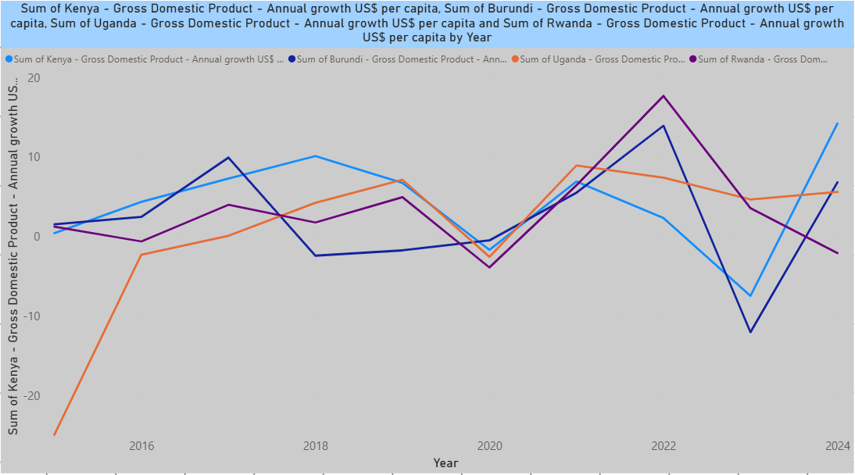
"Kenya leads regional growth while Burundi shows volatility"
Kenya maintains steady growth (peaking at 7.3% in 2021)
Rwanda's impressive post-2020 recovery overtakes Uganda
Burundi's dramatic 2023 drop (-12%) reflects political instability

Slide 4
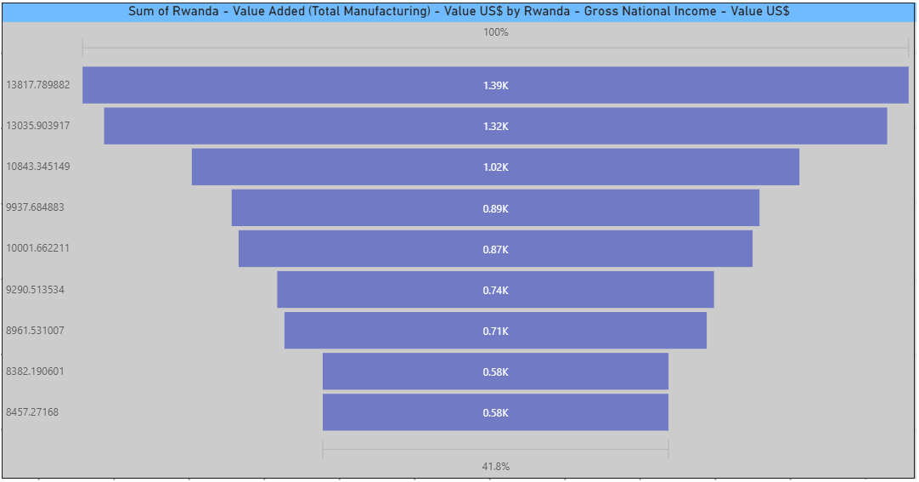
"Manufacturing growth aligns with rising national income"
Manufacturing value added shows consistent upward trend
Correlation suggests industrial sector driving GNI growth
Key Insight: 22% manufacturing growth spike in 2021

Slide 5
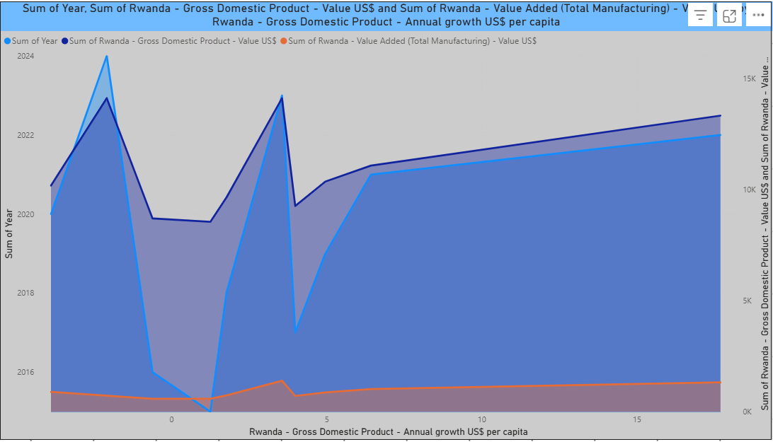
"Manufacturing outpaces overall GDP expansion"
Manufacturing growth rate exceeds GDP growth after 2018
2021 standout year with both metrics peaking
Suggests successful industrial diversification

Slide 6
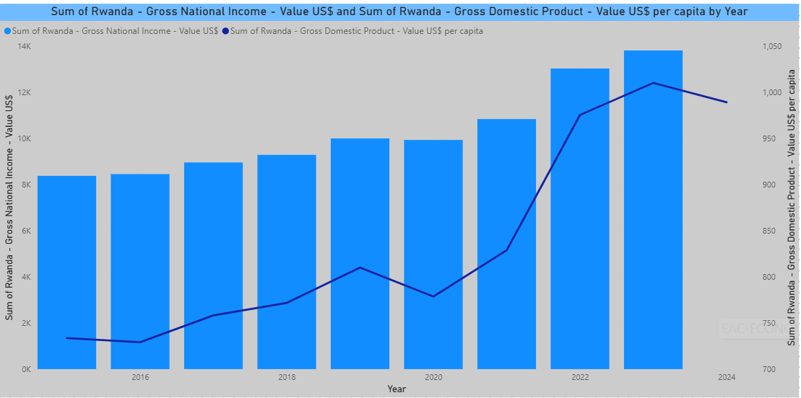
"Per capita gains mirror national income growth"
Parallel trends confirm broad-based economic benefits
2020 dip shows pandemic impact on both metrics
2022 recovery demonstrates resilience

Slide 7
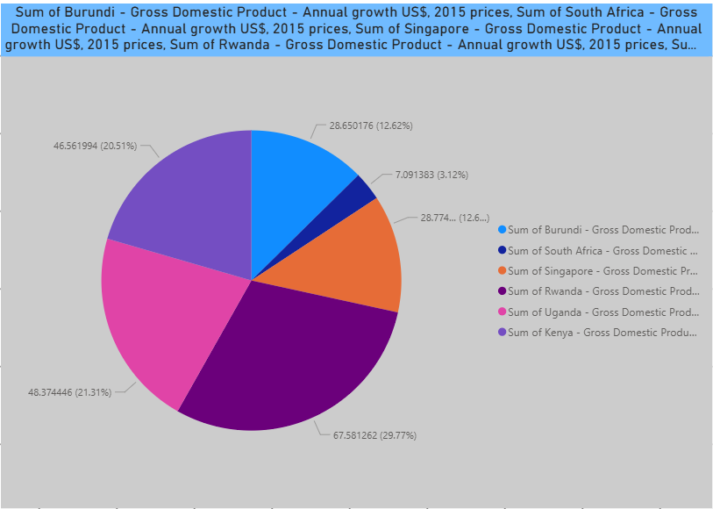
"Singapore and Kenya lead growth trajectories"
Singapore's advanced economy shows stable high growth
Kenya outperforms African peers consistently
South Africa's stagnation contrasts with Rwanda's rise

Slide 8
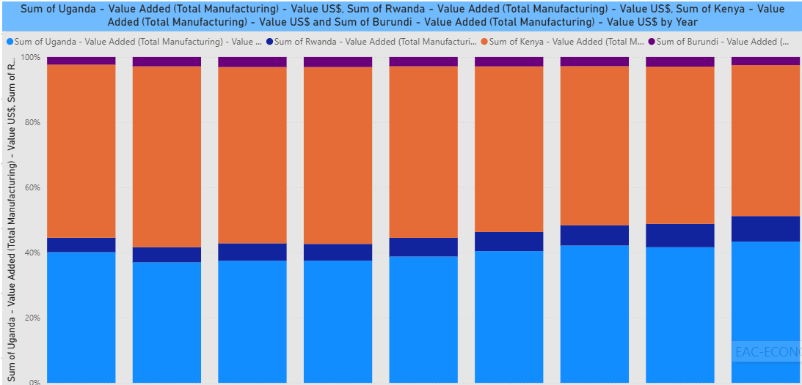
"Rwanda emerges as regional manufacturing leader"
Rwanda overtakes Uganda in manufacturing value by 2022
Burundi lags significantly behind neighbors
Rwanda's 10x growth since 2015 is standout story

Slide 9
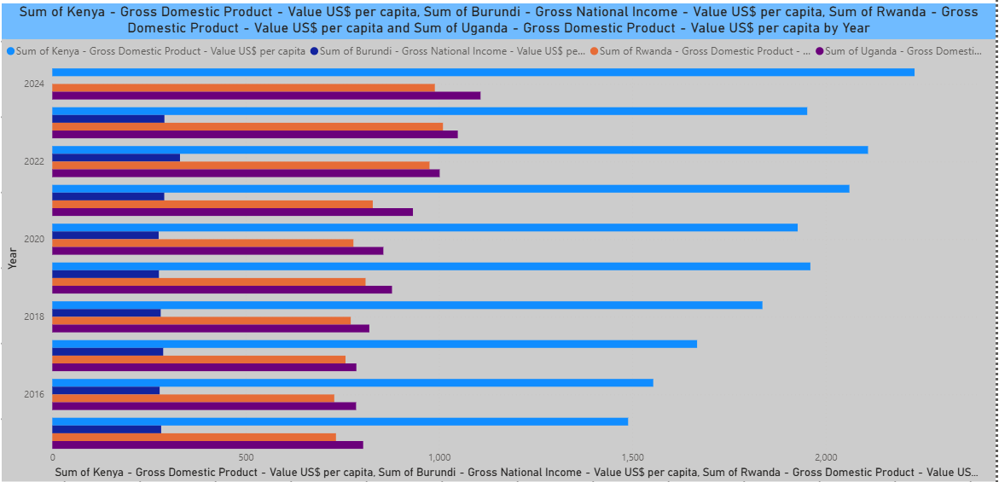
S
"Kenya's per capita lead narrows as Rwanda accelerates"
Kenya maintains highest per capita values
Rwanda's convergence trend evident post-2018
Burundi trails significantly (note scale difference)

Slide 10
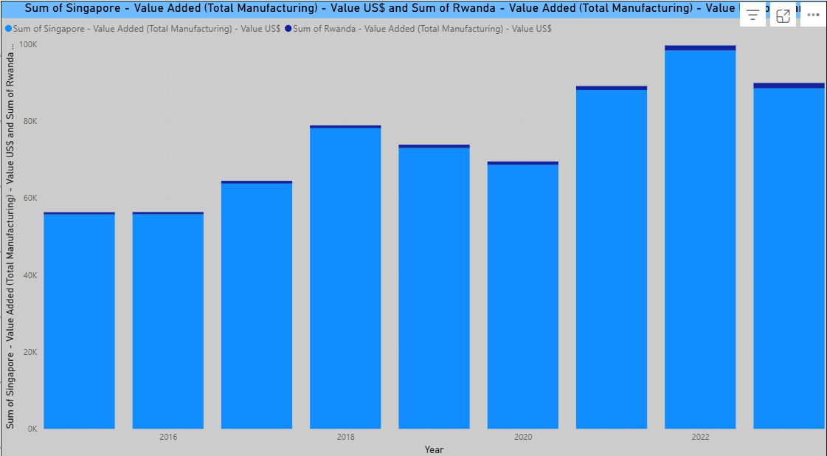
"Rwanda mimics Singapore's industrial growth pattern"
Singapore's massive scale difference (note log scale)
Similar growth trajectories despite size gap
Rwanda shows potential to follow development path

Slide 11
CONCLUSION
The analysis reveals both growth and disparity across East African economies. Countries like Rwanda and Tanzania showed consistent GDP and GNI improvements, while others had stagnating or inconsistent patterns. Sectoral data, especially in agriculture and manufacturing, offers insights into economic priorities and structural gaps. This visualization empowers users to explore these trends and make informed conclusions for policy or research.

Slide 12
THANK YOU

